Slide 1
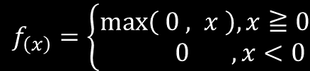

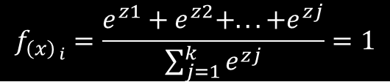
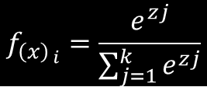
$f_{\left(x\right)}$ = $\frac{1}{{1 +e}^{−x}}$
$f_{\left(x\right)}=\left\{\begin{matrix}\max\left( 0 , x \right), x≧0 \\ 0 ,x<0\end{matrix}\right.$
$$f_{{\left(x\right)}_{ i}}=\frac{e^{zj}}{\sum_{j=1}^{k}{e^{zj}}}$$
$$f_{{\left(x\right)}_{ i}}=\frac{e^{z1}+e^{z2}+...+e^{zj}}{\sum_{j=1}^{k}{e^{zj}}}=1$$

Slide 2
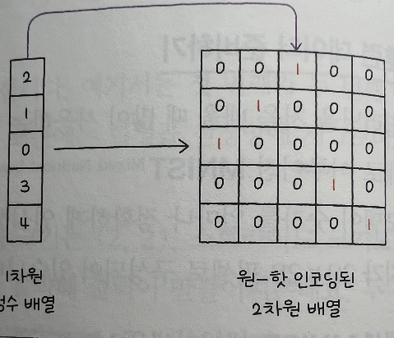
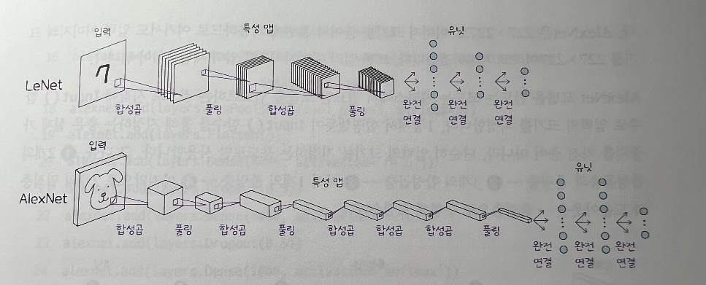
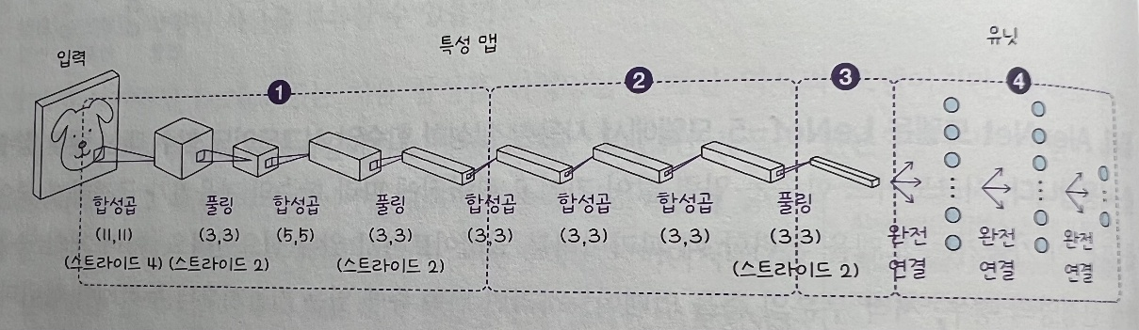
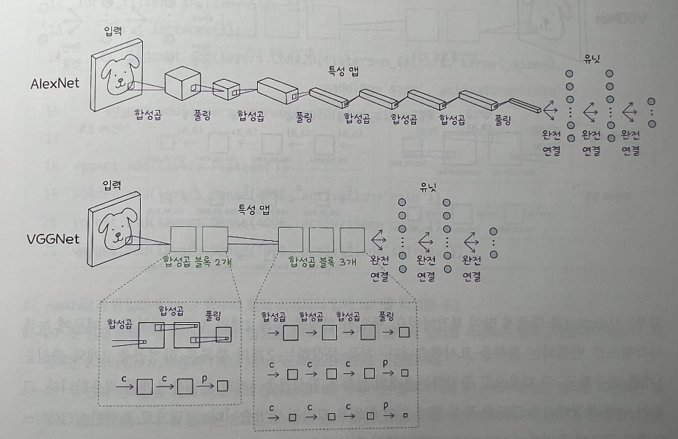

Slide 3
